Slide 1
THE BUILDING OF THE CHARACTER
CREATING CHARACTER
-Annie Besant and C. W. Leadbeater
-ANNIE BESANT

Slide 2
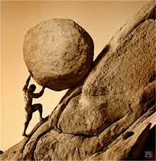
THE FIRST STEP
DEFINITE PURPOSE AND DELIBERATE ACTION

Slide 3
Right Thought, SPEECH, ACTION
For helping, strengthening, purifying the stream of flow of others consciousness.
Action is only the manifestation of what is within

Slide 4




IDEALS
"But we all, with open face beholding as in a glass the glory of the Lord, are changed into the same image from glory to glory."

Slide 5





TRAINING THE MIND

Slide 6
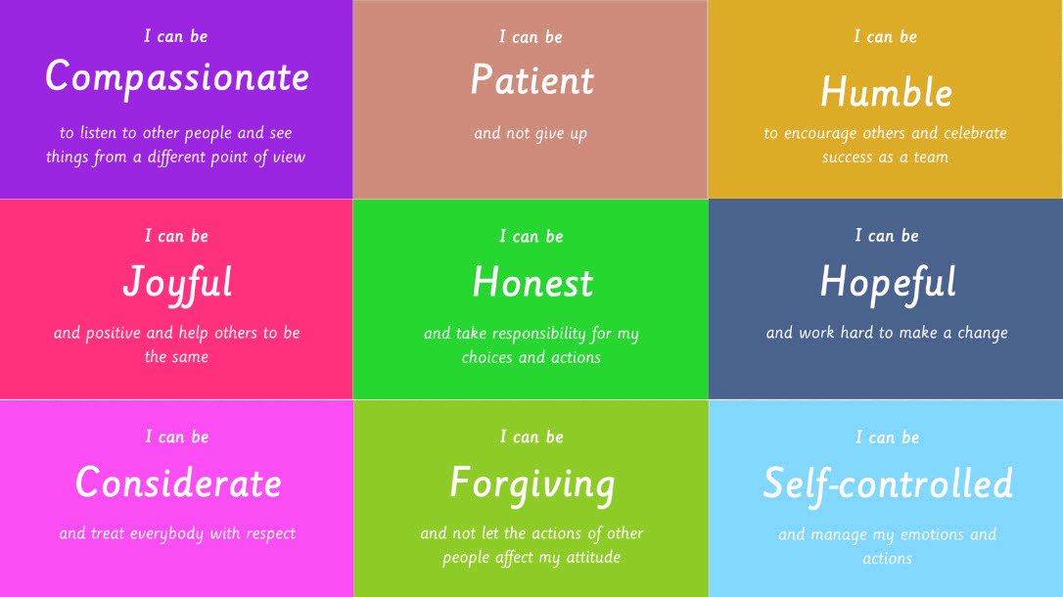
VIRTUOUS QUALITIES

Slide 7

PEACE AND LOVE
The pure heart has nothing to fear
Love, compassion, tenderness adds to what we are to make the best version of us

Slide 8


